Slide 1
GOVERNMENT DEFENCE
ANTI-CORRUPTION INDEX
Nick Seymour
Transparency International Defence & Security Programme
Institute for Security Studies
Pretoria, South Africa | February 22nd, 2013

Slide 2
DEFENCE Corruption - The problem
  DANGEROUS It undermines military effectiveness. Poor equipment risks the lives of troops
  DIVISIVE It destroys trust in government and the armed forces, and between personnel
  WASTEFUL The defence sector is worth $1.6 trillion a year. The waste from corruption is in billions of dollars.

Slide 3
Methodology
Questionnaire filled out by an expert independent assessor, reviewed by two independent peer reviewers, a government reviewer, and finally a TI National Chapter reviewer.
Objective answers where possible; reasoned assumptions acceptable where information is lacking.
77 questions, scored on a 5-point scale. Model answers guide assessor’s responses.
Structured according to the TI-DSP typology of corruption risks.

Slide 4
POLITICAL
PERSONNEL
PROCUREMENT
Defence Corruption Typology
Defence & security policy
Leadership Behaviour
Technical requirements / specifications
Defence budgets
Payroll, promotions, appointments, rewards
Single sourcing
Nexus of defence & national assets
Conscription
Agents/brokers
Organised crime
Salary chain
Collusive bidders
FINANCE
OPERATIONS
Control of intelligence services
Values & Standards
Financing packages
Export controls
Small Bribes
Offsets
Contract award, delivery
Subcontractors
Asset disposals
Disregard of corruption in country
Seller influence
Secret budgets
Corruption within mission
Military-owned businesses
Contracts
Illegal private enterprises
Private Security Companies

Slide 5
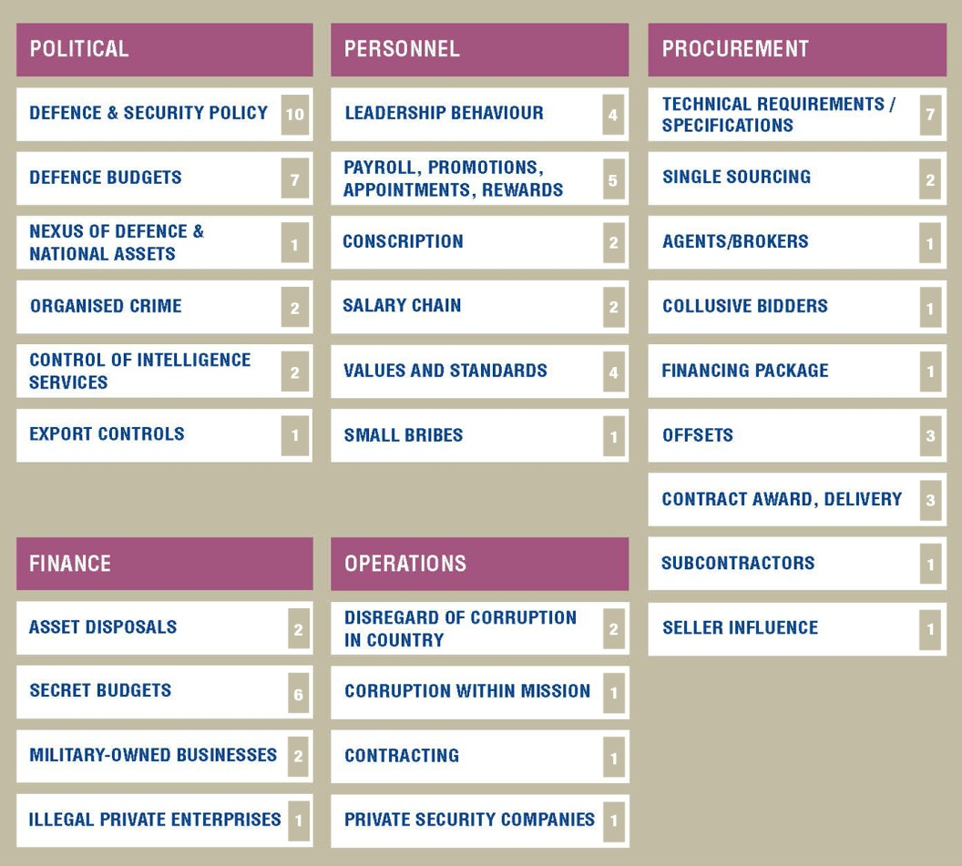
EXAMPLE QUESTION
Do personnel receive the correct pay on time, and is the system of payment well-established, routine, and published?
4. Personnel receive the correct pay on time. The payment system is well-established, routine, and published, and basic pay is non-discretionary.
3. Personnel generally receive the correct pay on time. However, there may be minor shortcomings in the clarity or transparency of the payment system, and basic pay may occasionally be subject to discretionary adjustments.
2. There are occasional indications of late payment (of up to 3 months) though payments are generally of the correct amount. There are considerable shortcomings in the clarity and transparency of the payment system.
1. There are regular indications of late payment (of up to up to 3 months) and payment amounts may regularly be incorrect. The payment system is not clear or published.
0. There are widespread and significant delays in payment (of over 3 months), and personnel are not guaranteed to receive the correct salary.
The TI-DSP typology of corruption risks

Slide 6
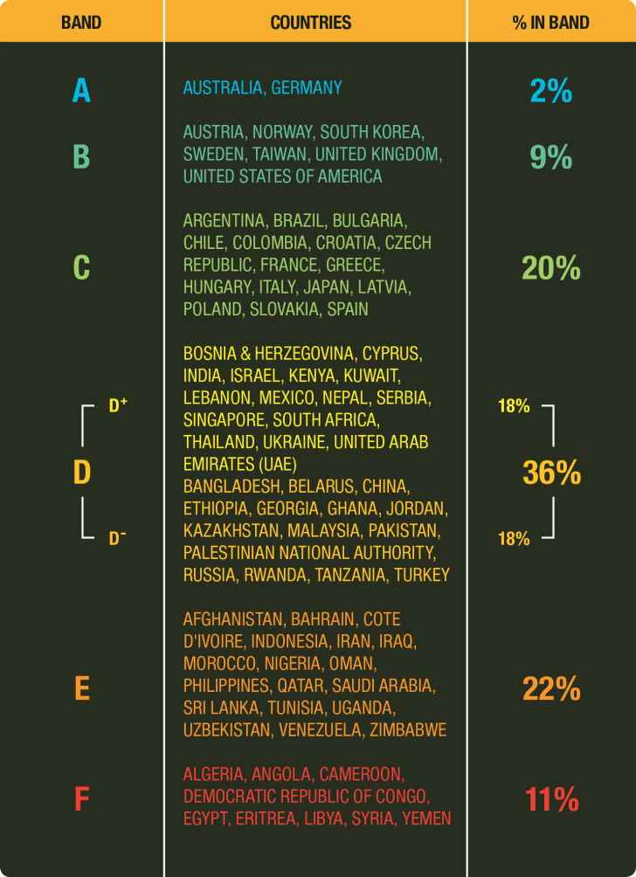
THE GLOBAL RESULTS

Slide 7
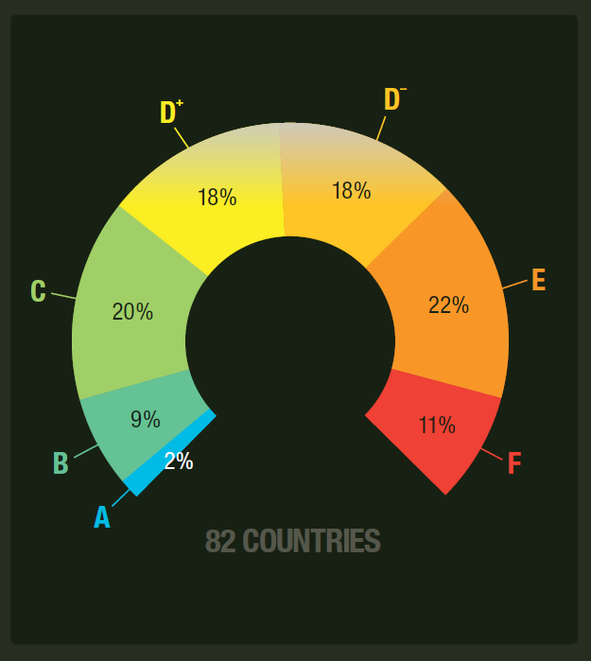
THE GLOBAL RESULTS
This Index shows for the first time the state of corruption controls in the defence sector across the world. And the results are dismal.
            Only 2 — Australia, Germany - have strong controls
            70% have poor or non-existent controls against corruption
            50% do not publish their defence budget, or minimally
            85% have no effective legislative scrutiny of defence policy
            90% have no effective system for whistleblowing in defence
One big positive: Many MODs acknowledge defence corruption and are ready to address it – unlike 10 years ago

Slide 8
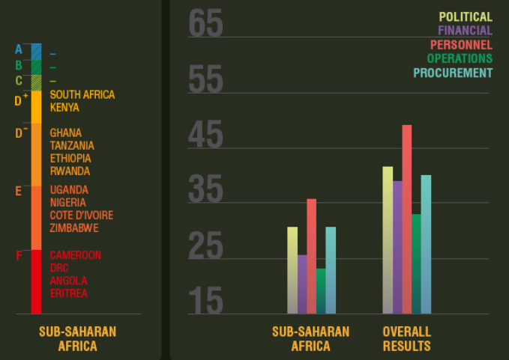
Average integrity scores by risk area
REGIONAL RESULTS | SUB SAHARAN AFRICA

Slide 9
Average integrity scores by risk area

Slide 10
Military spending: sub-saharan africa, 2000-2011 (in us$bn)

Slide 11
THE LOCAL REGION: RESULTS BY COUNTRY
SOUTH AFRICA - BAND D+
POLITICAL FINANCIAL PERSONNEL OPERATIONS PROCUREMENT
47%
55%
52%
35%
36%
+ Post-apartheid era has seen reforms to open legislative scrutiny of defence policy
+ Public debate of defence policy
+ Budget transparency and legislative scrutiny
+ Chains of command are separate from payment chains
+ Defence purchases are made public
+ Procurement legislation is in place; however, it may not be supported by resources and political will

Slide 12
THE LOCAL REGION: RESULTS BY COUNTRY
SOUTH AFRICA - BAND D+
POLITICAL FINANCIAL PERSONNEL OPERATIONS PROCUREMENT
47%
55%
52%
35%
36%
Portfolio Committee on Defence believed to lack some capacity, access to information. Anti-corruption bodies lack effectiveness and coordination
Lack of risk assessments
Poor export controls
Classification of information
Whistle-blower protection in law, but discouraged in practice
Procurement: cycle not disclosed; poor controls on tendering, agents and brokers; offsets high risk area; lacking requirements for companies.

Slide 13
RECOMMENDATIONS FOR LEGISLATORS, CIVIL SOCIETY, AND DEFENCE COMPANIES
Legislators Ensure the defence budget is public. A strong committee exercising oversight over defence. A strong sub-committee analysing items withheld from the public on the premise of ‘national security’.
Civil Society Open the dialogue with the Defence Ministry and Armed Forces. Contribute to oversight and policy making. Demand public availability of the full defence budget
Defence Companies Insist on strong anti-corruption systems. Collaborate with governments to reduce corruption. Competitive advantage.

Slide 14
President and Cabinet Insist that the military and Ministry of Defence be leaders in anti-corruption measures , not exempt
Defence leaders
Build common understanding of corruption.
Analyse the corruption risks in your defence context; develop a plan.
Change the processes on secrecy/confidentiality
Put in place a robust Code of Conduct and implement anti-corruption training
Implement strong controls over your procurement strategy; to be needs-based
Improve your whistle-blowing systems for personnel; protect those who report it
Demand higher standards of your contractors – national and international
Be open with the public in what you are doing: work with civil society

Slide 15
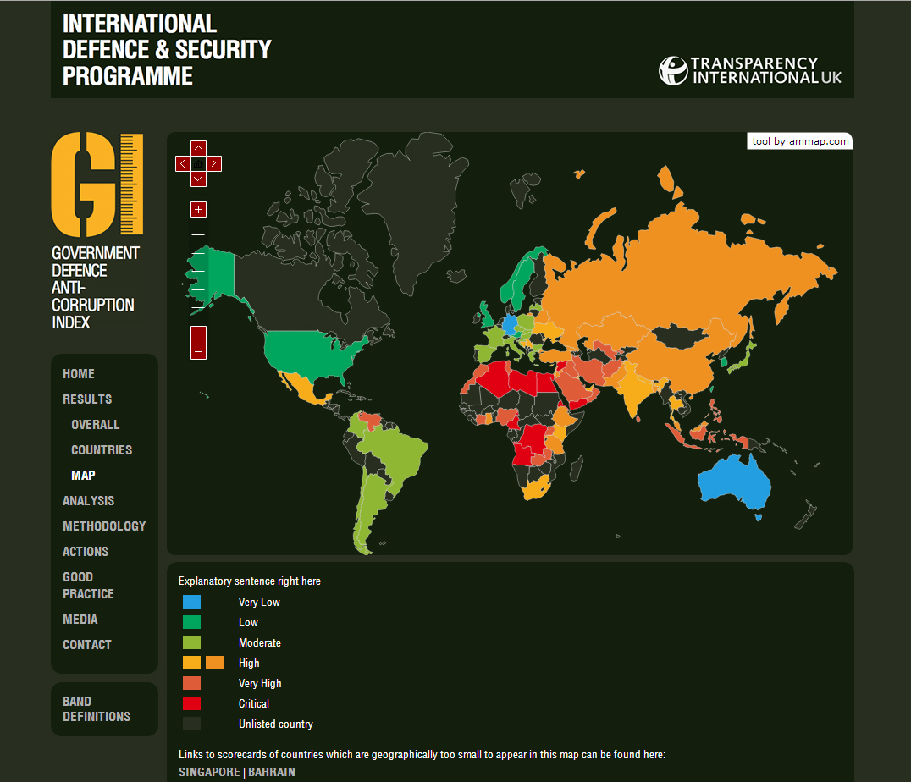
THE WEBSITE: www.defenceindex.org
www.ti-defence.org
www.defenceindex.org

